Slide 1

Consumer Complaint Data Analysis
Title: Consumer Complaint Data Analysis
Subtitle: Understanding Trends and Insights
Name- Smruti Priyadarsani Swain

Slide 2
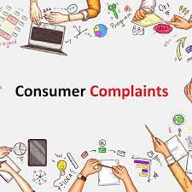
Agenda
1
Fast processing of Consumer complaints
2
Describing Reliable method of complaining and creating a complaint management system which will help managing complaints or queries received from the customers.
3
Explaining the process of documenting complaints and giving feedback
4
Building customer loyalty through effective complaint headline

Slide 3
Purpose of Customer Complaints Presentation
Identifying Trends
Objectives
Reputation Management
Understanding Root Causes
Customer Retention
Improving Processes

Slide 4

Business Requirement
1
Help to identify the loopholes of service delivery.
Gain insights about customers’ perception for your brand.
2
3
Learn about the most desirable features and how you can build better products.
Demonstrates our commitment to customer satisfaction and builds trust and loyalty.
4

Slide 5
Data collection Methods and Categories
Sources : Online forms, call centers, social media, email, in person
Time Frame : Monthly(Jan, 2024 – May 2024)
Tools: CRM Systems, specialized software, spreadsheets
Data Collection
Data Cleaning: Describe the process of cleaning the raw data to remove duplicates, errors, and inconsistencies.
Data Formatting: Explain how the data was formatted for analysis, including standardizing categories and resolving discrepancies.
Missing Data Handling: Discuss how missing or incomplete data points were addressed, if applicable.
Data Cleaning and Preparation

Slide 6
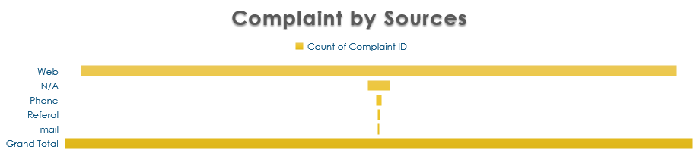
Overview of Chats

Slide 7
Complaint by issue

Slide 8



Observation of Consumer Complaint
Product
Resolution
Closed with monetary relief is 2% and Closed with non-monetary relief is 42%
There were few responses on time to consumer
Sources
Most of responses are on website. Rather then call most consumer give complaint on website
Total number of complaints are 89961
Most of the complaints : Credit reporting or other personal consumer reports

Slide 9

Data Analysis
Response
94% Timely reposes to consumer after complaints
Monthly Trends
In month of February there are highest complaints of products
In may there is no complaints from customers
Issue
Most of the issue are Incorrect information on the report
There are few comments on Dealing with the lender or servicer

Slide 10
Root Cause Analysis
Incorrect information on your report
Marketing and Communication
Common complaints
Improper use of
your report
Factors
consumer dissatisfaction
Product/Service Related Factors
Company's investigation
into an existing problem
Psychological and
Social Factors

Slide 11
Solutions and Recommendations
Implement Robust Quality Control Measures:
Regularly assess product/service quality at various stages of production or delivery.
Establish quality benchmarks and standards to ensure consistency and reliability.
Invest in Training and Development:
Provide ongoing training and development programs for employees to enhance their skills and knowledge.
Focus on customer service training, conflict resolution, and effective communication techniques.
Optimize Product/Service Design:
Gather user feedback during the design and development phases to ensure products/services meet customer needs and preferences.
Continuously iterate and improve products/services based on user feedback and market trends.

Slide 12

Future Trends
Rise of Digital Complaint Channels: With the increasing use of digital platforms and social media, consumers are likely to utilize these channels more for lodging complaints.
Expansion of Customer Advocacy Groups: Consumer advocacy groups and watchdog organizations may gain more influence in shaping consumer rights and holding businesses accountable for their actions.
AI driven analytics: Data Collection and Preprocessing, Natural Language Processing (NLP), Topic Modeling, Continuous Improvement : Implement feedback loops to continuously refine and improve AI-driven analytics models based on new data and insights.

Slide 13
Conclusion
Key Takeaways:
Identification of Trends: Through our analysis, we have identified common trends and patterns in consumer complaints, allowing us to prioritize areas for improvement and strategic intervention.
Insights into Root Causes: By delving into the root causes of complaints, we have uncovered underlying issues affecting product quality, service delivery, and customer experience.
Next Steps:
Actionable Recommendations: Based on our insights, we will develop actionable recommendations for addressing identified issues, improving customer satisfaction, and fostering long-term loyalty.
Continuous Monitoring and Evaluation: We will establish mechanisms for continuous monitoring and evaluation of complaint data, enabling us to track progress, measure outcomes, and adapt strategies as needed.

Slide 14
THANK YOU

